Slide 1

I speak
Python

Slide 2
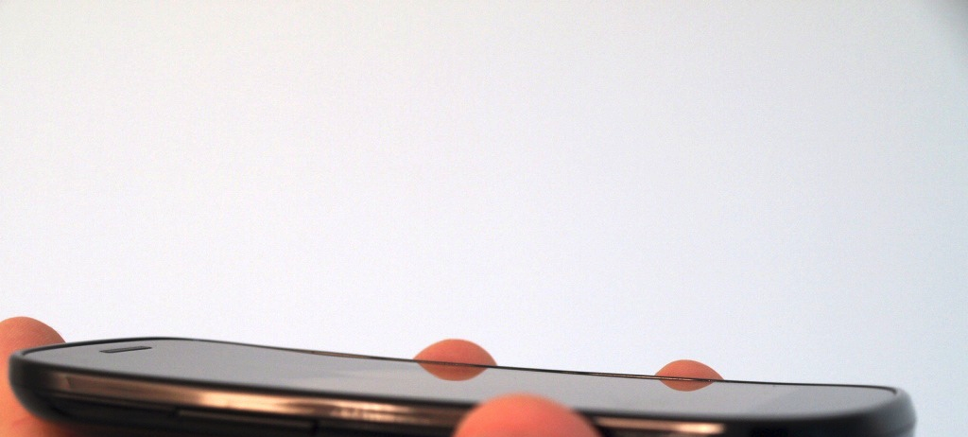



Building a smartphone seismic network
Qingkai Kong
Richard Allen
Louis Schreier

Slide 3
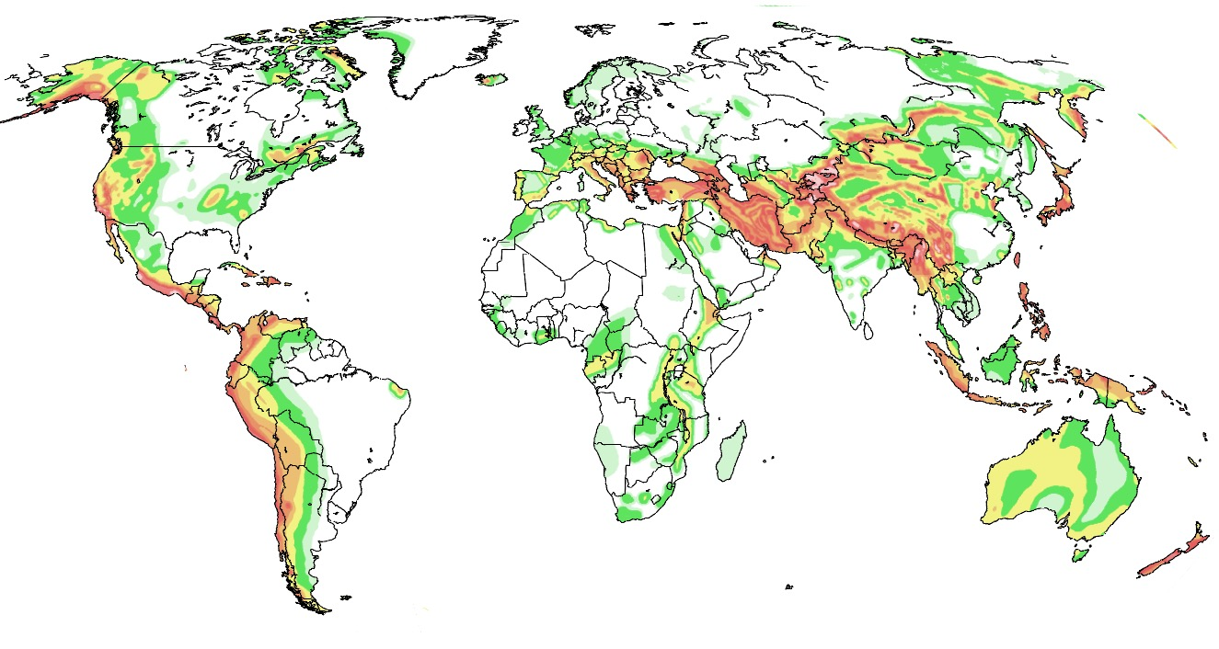
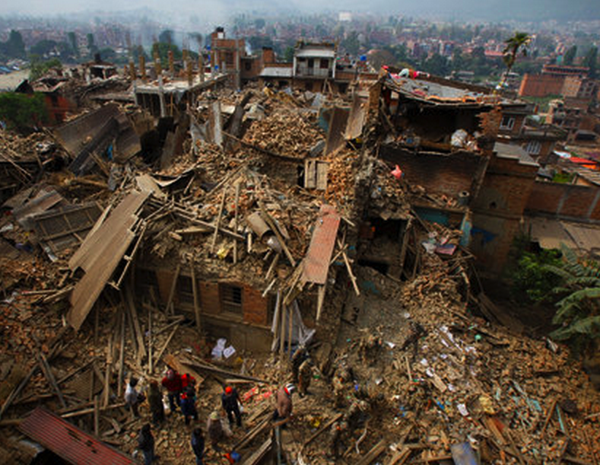
A global test
for a global hazard
Earthquake hazard
Few seismic stations
6 million smartphones
➔ 20 sec warning
Katmandu, Nepal
April 2015, M7.9: 8000 fatalities
Notes:
8000 fatalities – April 2015 – M7.8
Population of Nepal: 26.5M, telcom users 21.6M or 82% …most are mobile users: 73% of population (v small land-line user)
Penetration of smartphones is around 30%, up from ~15% a year ago …rapid growth.
So, number of smartphones: 30% of 80% x 26M = 6 million
Population in the Katmandu area (three adjacent cities) is 2.5M x30%x80% = 600,000

Slide 4



















Is this an Earthquake?

Slide 5
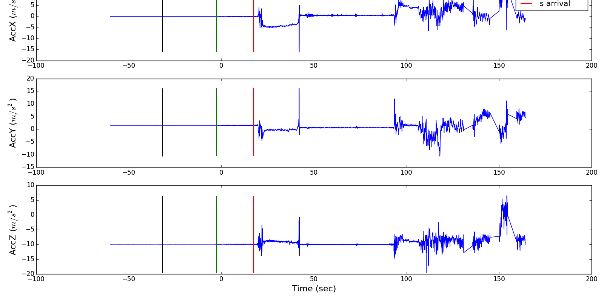
Recording at 170 km
Time zero is trigger time

Slide 6
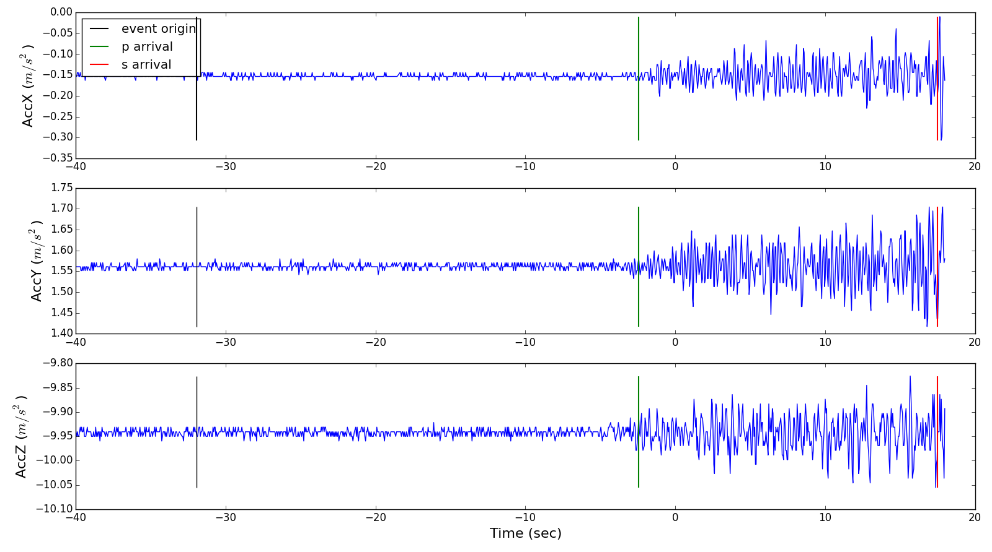
Recording at 170 km zoomed in

Slide 7
Earthquake Example

Slide 8
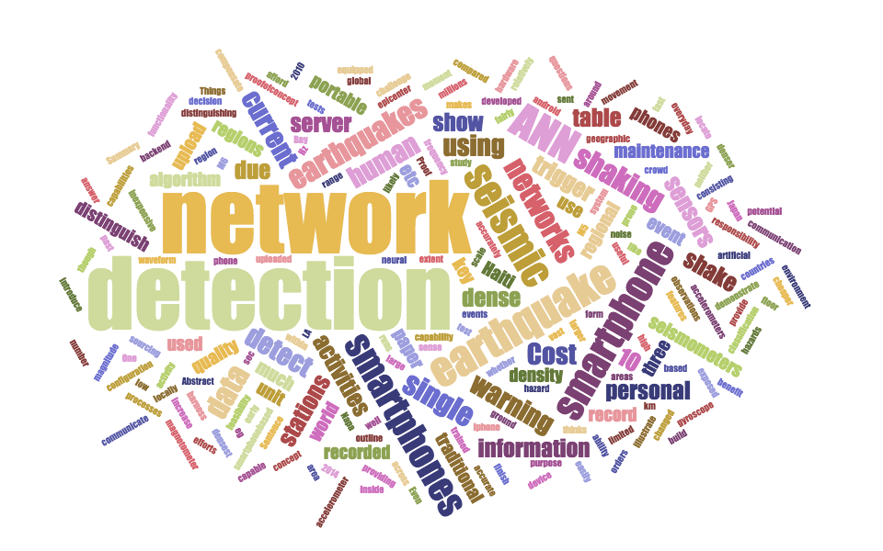

Slide 9
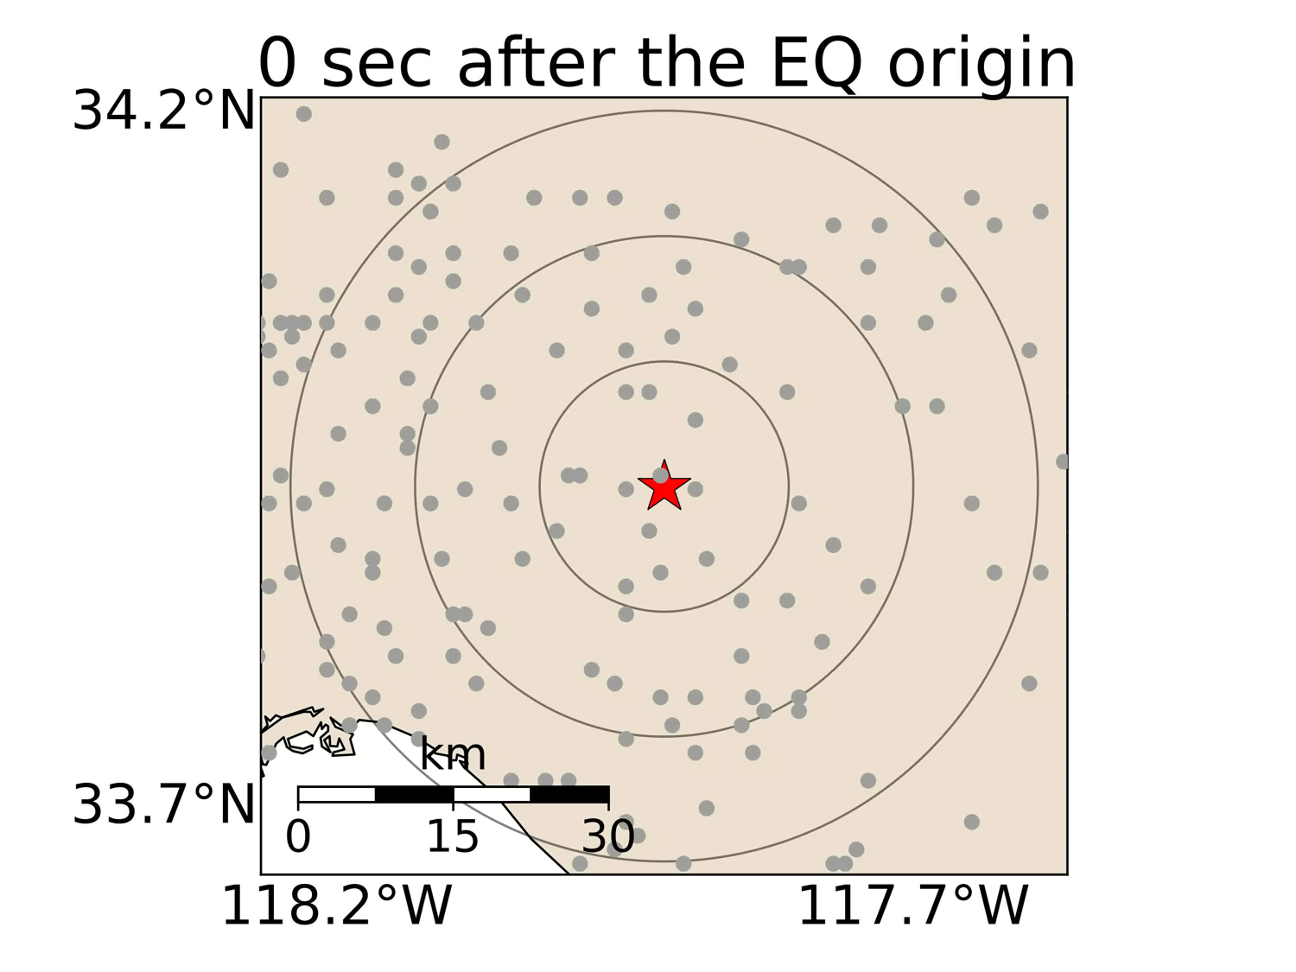

Slide 10



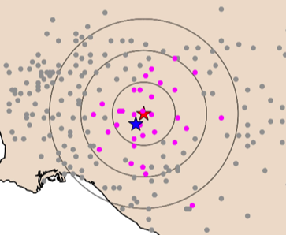
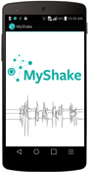

How
works
Real-time analysis
research and development
waveform analysis
Earthquake detection
download the free app
.berkeley.edu

Slide 11
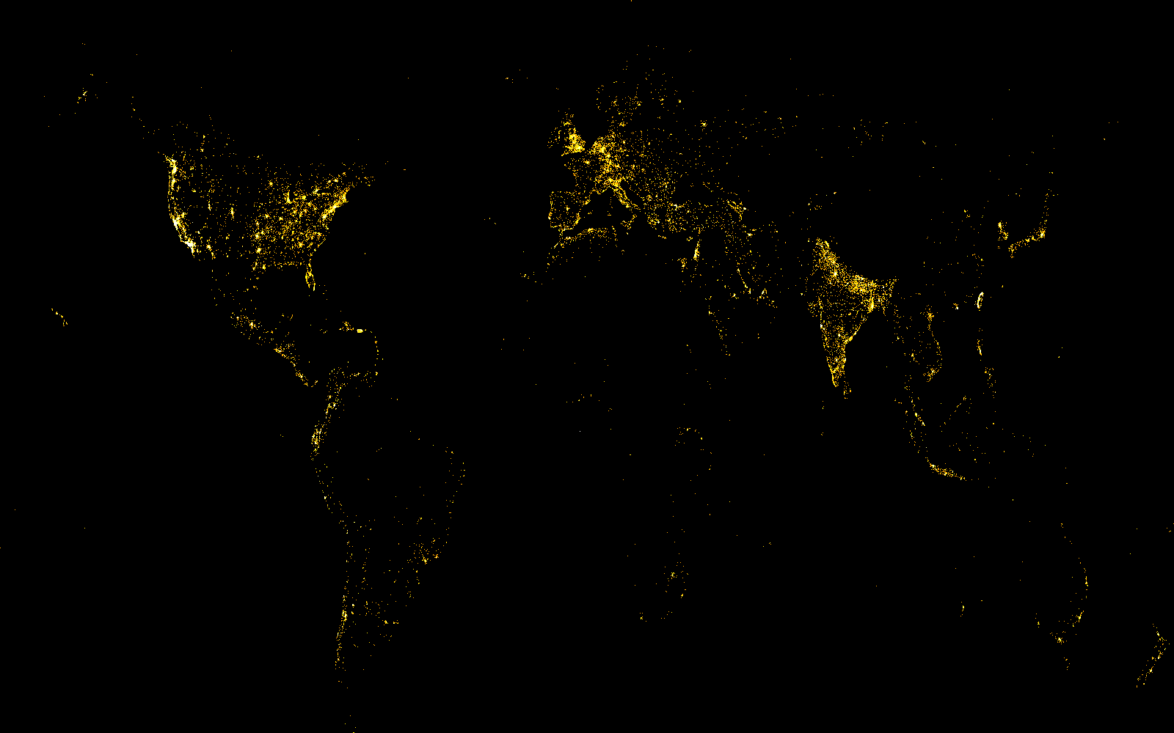
MyShake @ 200,000 installs

Slide 12
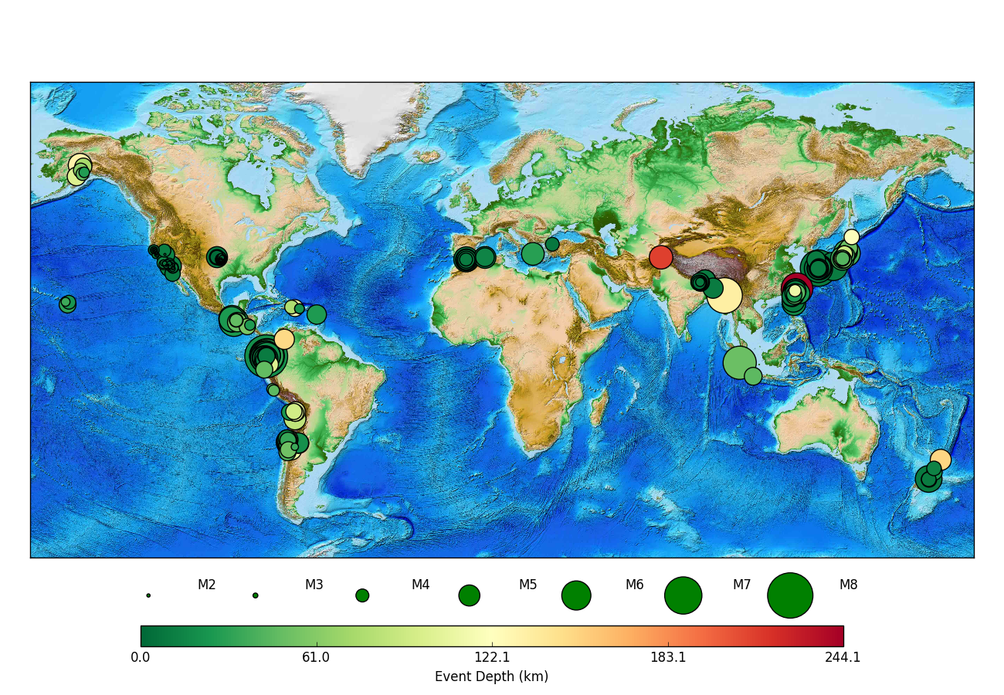
More than 200 earthquakes detected

Slide 13

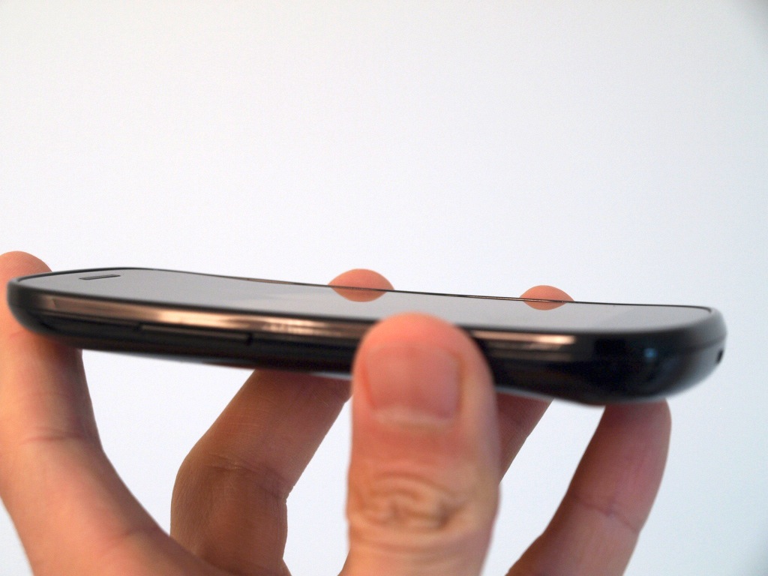
Thank you very much!
myshake.berkeley.edu

Slide 14



